Slide 1
Operators and decision constructs
Module 3

Slide 2
Content
Operators
Operator precedence
Expressions
Blocks
Logical operations: if, if-else, nested if-else, switch
Facts about the quiz

Slide 3
Operators
Specify operations
Return a result
Classified based on the functionality they are providing
Arithmetic operators
Unary operators
Equality and Relational operators
Conditional/Logical operators
Ternary operator
Bitwise operator

Slide 4
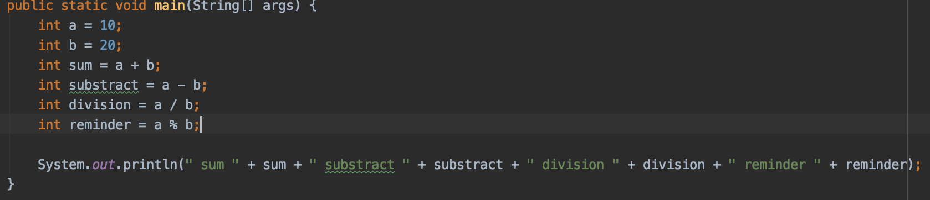
Operators
Arithmetic operators
+ Additive operator (also used for String concatenation)
- Subtraction operator
* Multiplication operator
/ Division operator
% Remainder operator
Output: sum 30 substract -10 division 0 reminder 10

Slide 5
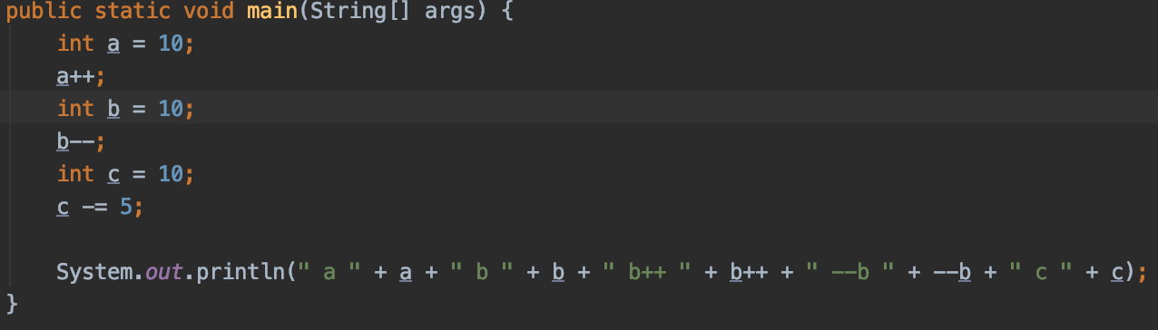
Operators
Unary operators
+ Unary plus operator; indicates positive value (numbers are positive without this, however)
- Unary minus operator; negates an expression
++ Increment operator; increments a value by 1
-- Decrement operator; decrements a value by 1
! Logical complement operator; inverts the value of a Boolean
Output: a 11 b 9 b++ 9 --b 9 c 5

Slide 6
Operators
Ternary operator
condition ? if true : if false

Slide 7
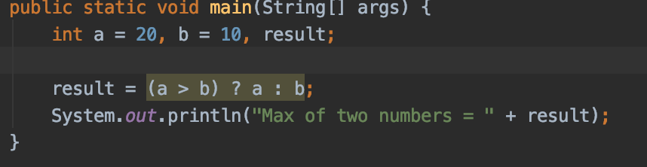
Operators
Equality and Relational Operators
== Equal to
!= Not equal to
> Greater than
>= Greater than or equal to
< Less than
<= Less than or equal to
Output: Max of two numbers = 20

Slide 8
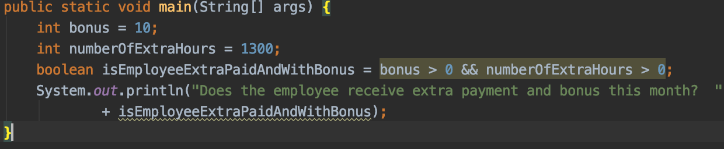
Operators
Conditional/Logical operators
&& Conditional-AND
|| Conditional-OR
Output: Does the employee receive extra payment and bonus this month? true

Slide 9
Operators
Bitwise operator
~ Unary bitwise complement
<< Signed left shift
>> Signed right shift
>>> Unsigned right shift
& Bitwise AND
^ Bitwise exclusive OR
| Bitwise inclusive OR

Slide 10
Operators
Bitwise operator
Int a = 60, b = 13;
In bits these are:
a = 0011 1100
b = 0000 1101
a&b = 0000 1100 (or 12)
a|b = 0011 1101 (or 61)
a^b = 0011 0001 (or 49)
~a = 1100 0011 (or -61)
a << 2 = 1111 0000 (or 240)

Slide 11
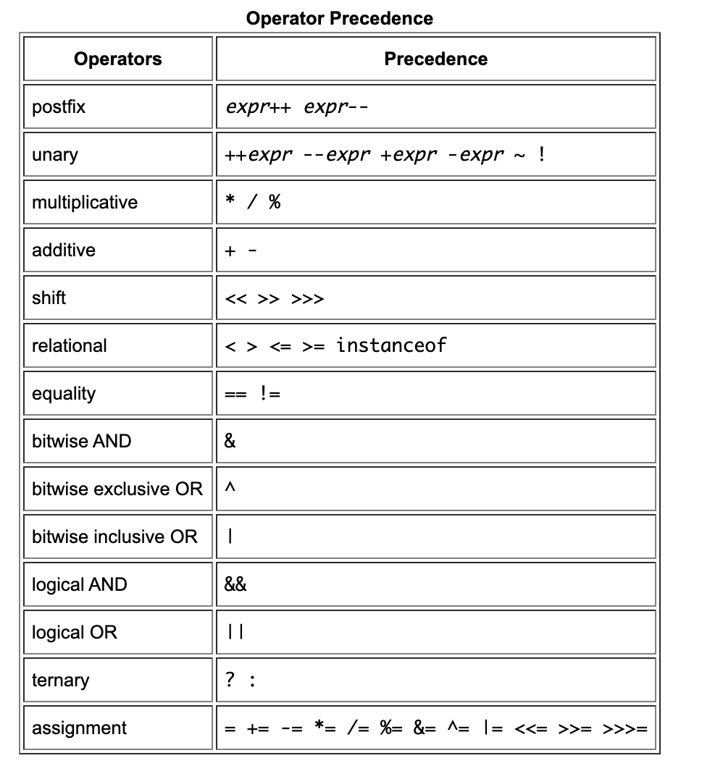
Operator precedence

Slide 12
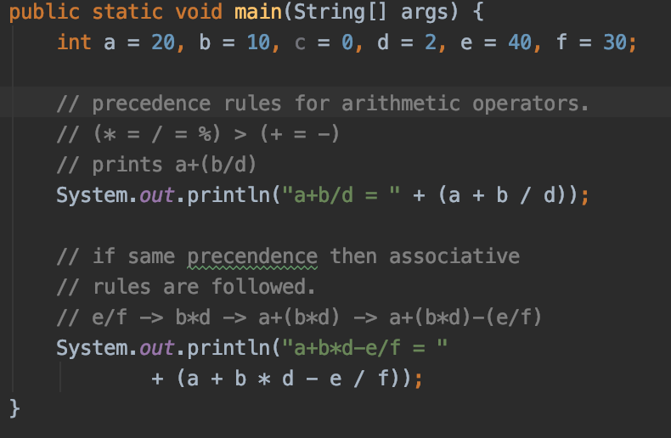
Operator precedence
Output: a+b/d = 25
a+b*d-e/f = 39

Slide 13
Demo
Javaoperators_demos_3 -> OperatorCommander

Slide 14
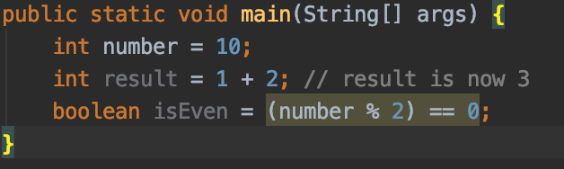
Expressions
construct made up of variables, operators, and method invocations
Evaluates a single value

Slide 15
Expressions
For Boolean based expression bare in mind when we do have && in them – the first occurrence of false does not leads to the following execution
boolean flag = true && false && true -> does not go to the 2-nd true
int a = 10;
boolean flag = true && false && a++ == 10; then a is 10 as we don’t go to the 3-th part

Slide 16
Blocks
Statement
Unit of operations
Int a = 12; // assignment statement
Int number = a + b // arithmetic statement
System.out.println(“Hey“) // method invocation statement
Block
Zero or more statements between balanced braces -> {}

Slide 17
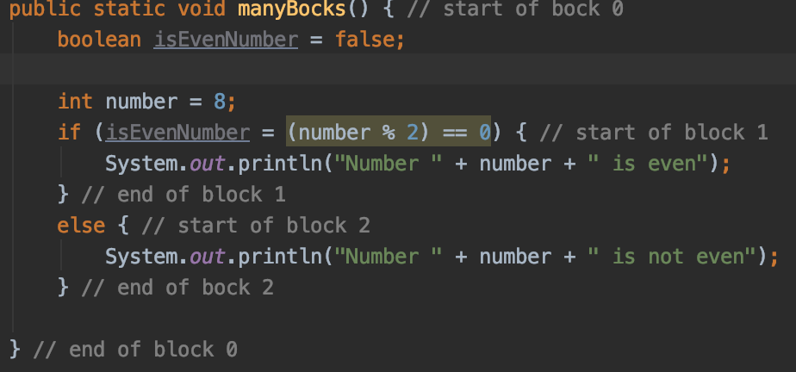
Blocks

Slide 18
Demo
Javaoperators_demos_3 -> expressions -> BlocksDemo

Slide 19
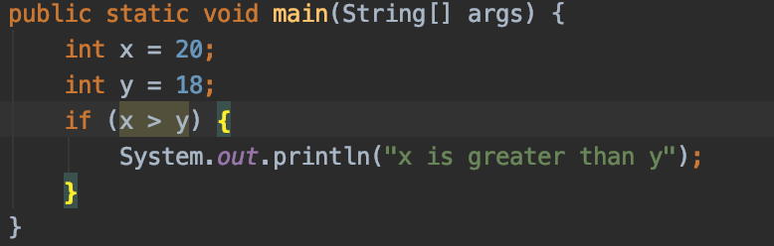





Logical operations: if
If statement
If (statement) {
// logic for true
}
true
Logic for true
Block of if
Test expression
Other continue
false

Slide 20
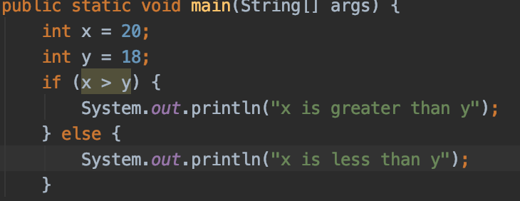







Logical operations: if-else
If-else statement
If (condition) {
} else {
}
true
True block
Test expression
false
False block

Slide 21
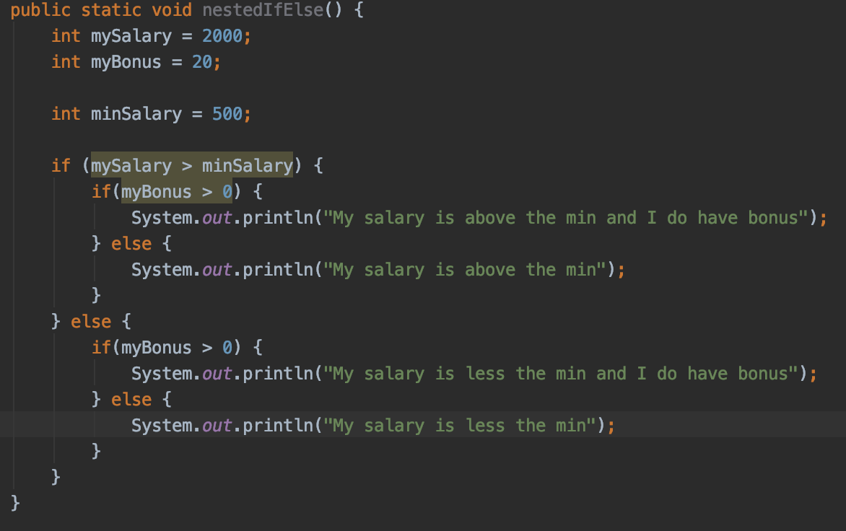
Logical operations: nested if-else
Nested if-else

Slide 22










Logical operations: switch
switch (expression)
{
case value1: statement1; break;
case value2: statement2; break; . .
case valueN: statementN; break;
default: statementDefault;
}
Switch cond expr
Statement 1; break;
Case cond 1
Case cond 2
Statement 2; break;
Statement n; break;
Case cond n
Def statement
Default cond

Slide 23
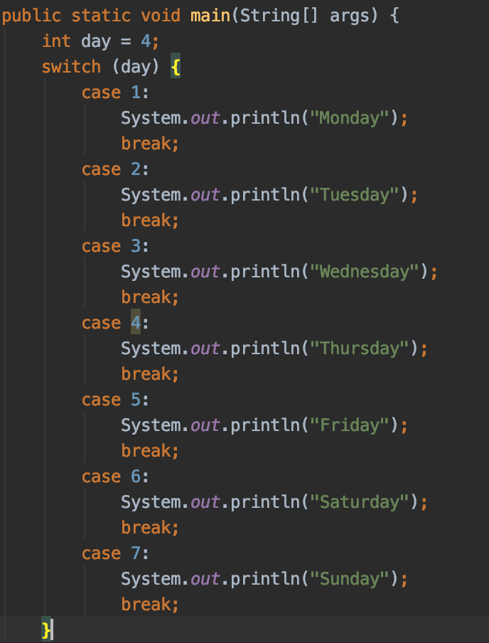
Logical operations: switch

Slide 24
Demo
Javaoperators_demos_3 -> expressions -> LogicalExpressions

Slide 25
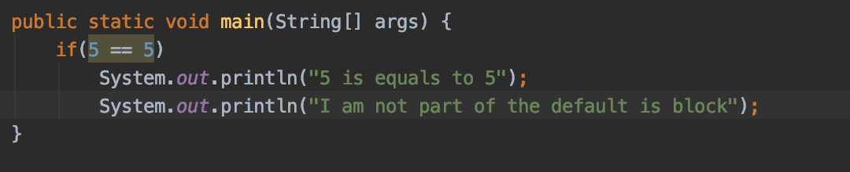
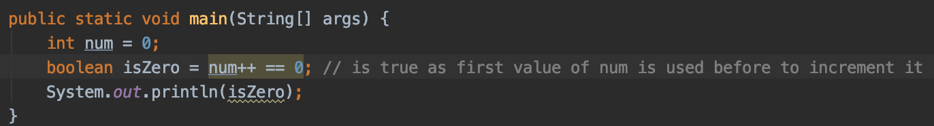
Facts about the quiz
For if based statements if there are no braces them only one line in the code is assume to be part of if
for ++ or – remember that

Slide 26
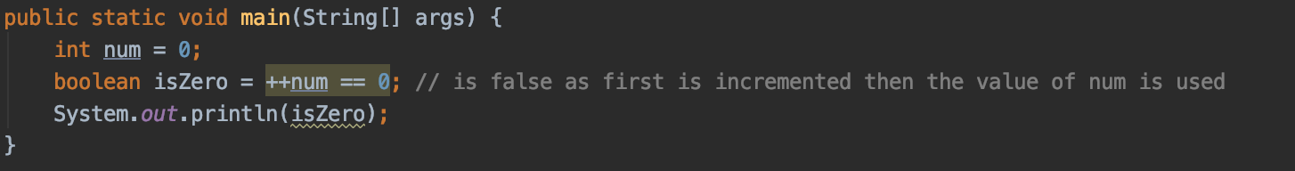
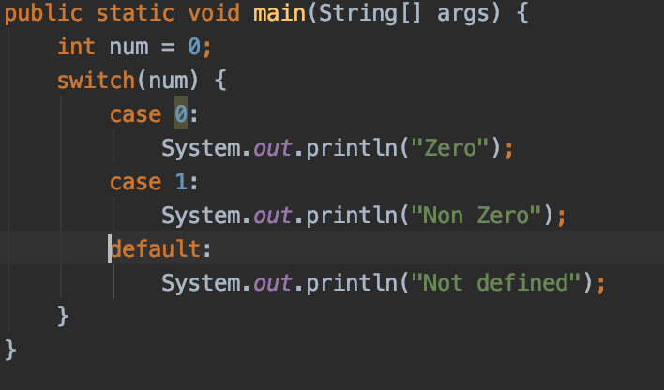
Facts about the quiz
In switch break; is used to stop executed any other case or default clause – if no break is. Included, then all cases and default clause will be executed once there is a match the case
Result is: Zero
Non Zero
Not defined

Slide 27
Facts about the quiz
A switch works with the byte , short , char , and int primitive data types and String, Enum types, Byte, Short, Integer, Character. Not with long, double and etc
Any more ?

Slide 28
Exercises
Javaoperators_3 -> expressions

Slide 29
Questions?
Notes:
Do you have any questions?

Slide 30
Thank You For Your Time

